Slide 1

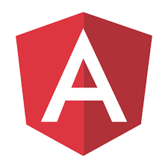

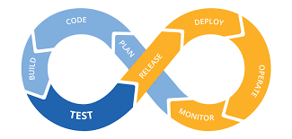
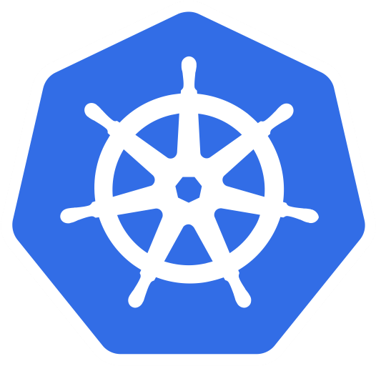
Louis Bertin NDJOMO
Mobile Lead Engineer
French, English
13 years of experience
Spring boot
Angular
Java
CI / CD
Kubernetes
Graduated with a master's degree in computer science in 2006 and a Master 2, and with more than 13 years of professional experience acquired in different companies. I acquired several qualifications during my various missions. Whether from a technical point of view or from a team management point of view.
I had the opportunity to participate in several ambitious development programs such as the design of a cross-platform management software package for more than a hundred users spread over several geographical sites. These applications are often related to web services, mobile applications, micro-services, I also have very good skills in this area where I am able to design and implement application architectures.
I also have strong skills in project management and team management in agile methodology.
During my previous missions, I have always shown rigor and adaptability. My taste for teamwork allowed me to solve many difficulties.
Photo
Expertise
Skills
Development of powerful and complex Android / Web applications.
Development in Kotlin, migration of Java applications to Kotlin or 100% Kotlin development.
Management of sources via Git (Gitflow)
Implementation and use of continuous integration and delivery processes (Bitrise, Fastlane, Jenkins)
I am an open-source contributor for SugarLabs and I participate every year to the Google Summer of Code as a mentor.
DEVELOPER: Creation of Web (React) and Mobile (Kotlin) applications for and with my clients.
MANAGER: I regularly follow up 4 people.
TECHNICAL RECRUITER: I correct recruitment exercises and conduct technical interviews for our Android candidates.
CONFERENCE ORGANIZER: I co-organize Talking.kt, our Kotlin conference.
SPEAKER: I regularly speak at meetups and conferences.

Slide 2
Professional background
Publications
2016 - XEBIA Android / Web developer. recruiter, manager and speaker
2015 - TF1 Android developer / FullStack developer
2014 - LE SPOT BOUYGUES FullStack & Android Developer
2014 - Programmez! No. 172: Introduction to Google Glass development
2014 - Programmez! N° 171 : Return on our participation to the APIdays hackathon
2013 - Programmez! N° 169 : Introduction to Android development
Events
2020 Android 2020 Security Health Check French Android User Group - FRAUG + TechAway + KED (Remote)
2020 Google Summer of Code Feedback Knowledge Exchange Day (Paris, France)
2019 Securing Network Calls on Android, from 2009 to 2019 Android Makers + Xebicon 19 (Paris, France)
2019 Android and software quality Xebicon 19 (Paris, France)

Slide 3

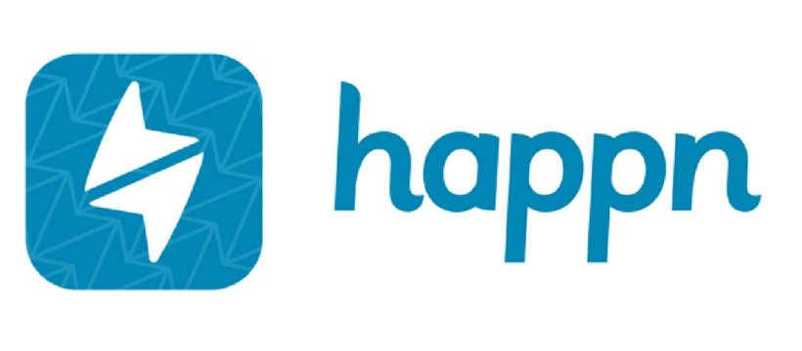
Details of the latest missions
McDonald’s
1 year and 5 months
Techlead Android
McDonald's France is the French subsidiary of the international fast food chain McDonald's
The application has been rewritten from scratch in order to offer a more fluid user experience and to make strong technological choices for maintenance and scalability.
Architecture
MVI
Kotlin Coroutines and Flow
Modularity
Quality metrics
Code coverage
SonarQube
Continuous integration
Bitrise
Firebase App Distribution
Agile Methodology
React and Typescript Developer
3 months
Happn
Happn is a dating application based on the principle "Find who you meet".
Creation of the architecture and development of the web version of Happn in React and Typescript for computers, tablets and mobiles.
Architecture
React / Redux
Typescript
Quality metrics
Code coverage
SonarQube
ESLint
Continuous integration
Google Cloud Build
Firebase App Distribution
Agile Methodology

